Slide 1

LIFE SENTENCES: The Six-Word Memoir
“Say it all
in six
words.”

Slide 2
Legend has it, Ernest Hemingway was challenged to write a short story in only six words. His response?
For sale:
baby shoes,
never worn.

Slide 3
SMITH magazine teamed with TWITTER for a Six-Word Memoir Contest in November 2006.
11,000 entries later, Not Quite What I Was Planning was published.
SMITH maintains a website dedicated to daily memoirs (caution advised for blunt language).

Slide 4
Follow-up editions include:
It All Changed in an Instant
I Can’t Keep My Own Secrets: Six-Word Memoirs by Teens with its own website
Six-Word Memoirs on Love & Heartbreak

Slide 5
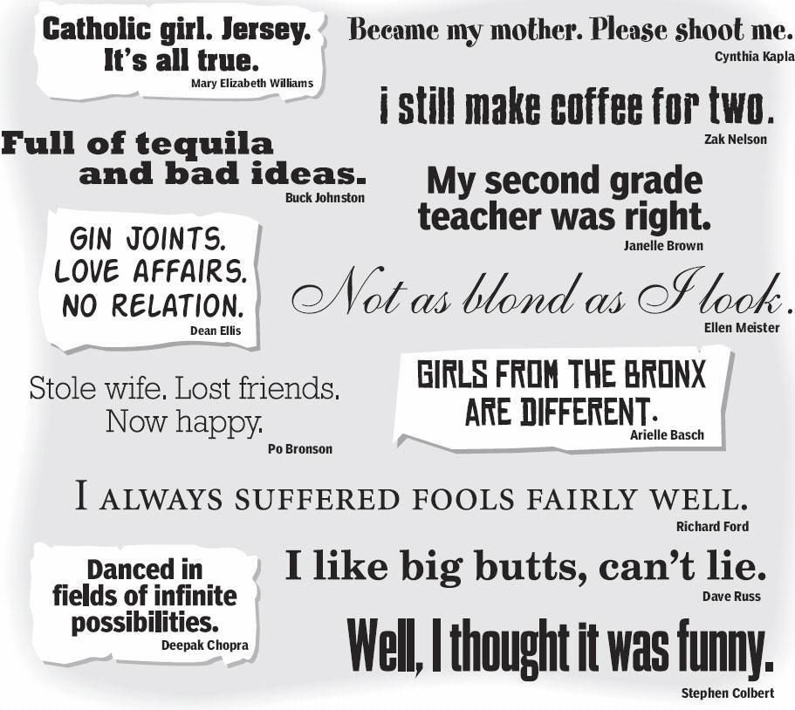

Slide 6
The results are at times devastating, poignant, and hilarious. Each six-word memoir can jumpstart classroom discussion. Each is a nugget for a larger story, and universal themes abound.

Slide 7

Life: Dream big! Revise. Edit. Repeat.Becky Alfaro
I only tell truth in journals. Sarah White

Slide 8
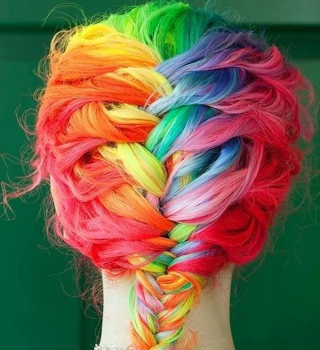
A house without pets isn't home.Jennifer Swedoski
Finally learned “weird” is a compliment. Kathryn Andrews

Slide 9

Love hurts, but I’m not broken.
Emma Roberts

Slide 10

Not enough room in the margins. Helen Thomas

Slide 11
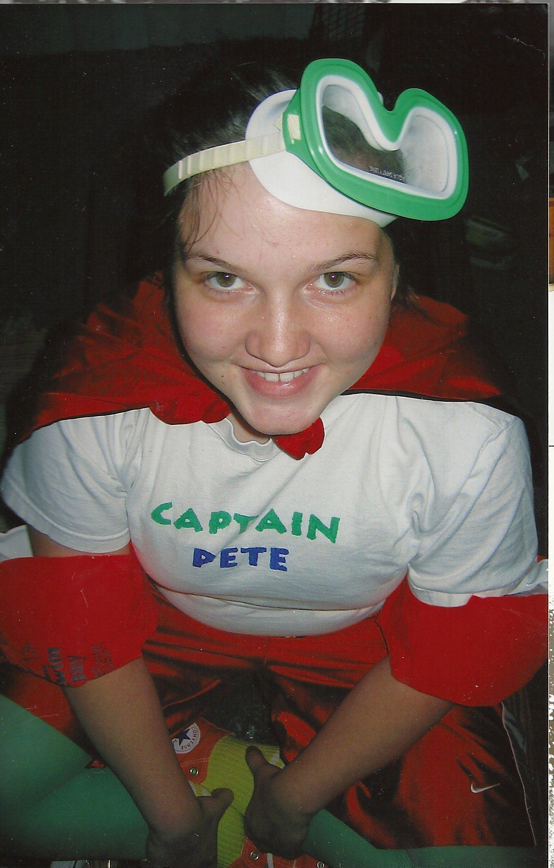
Dreams too big for this town. . .Megan Moore

Slide 12
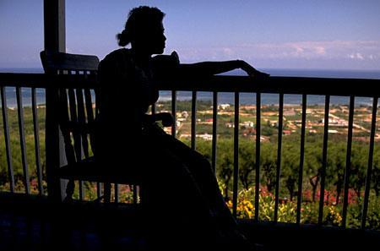
You still smell like my childhood. Caryn Lewis

Slide 13
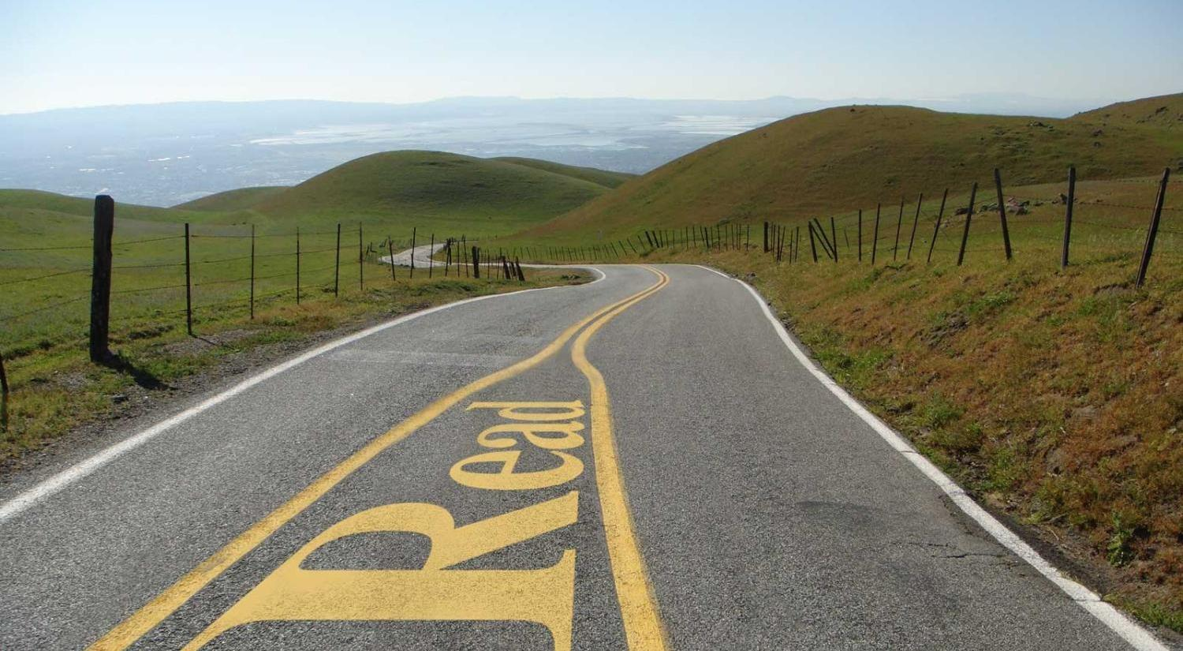
I stopped reading between the lines.
Alix Frank

Slide 14
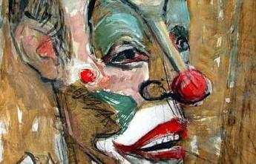
I always imagine clowns without makeup.
Jordan Harris

Slide 15
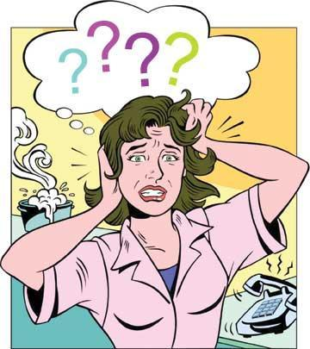
Roots are shallow, wings are broken.
Lori Vicars

Slide 16
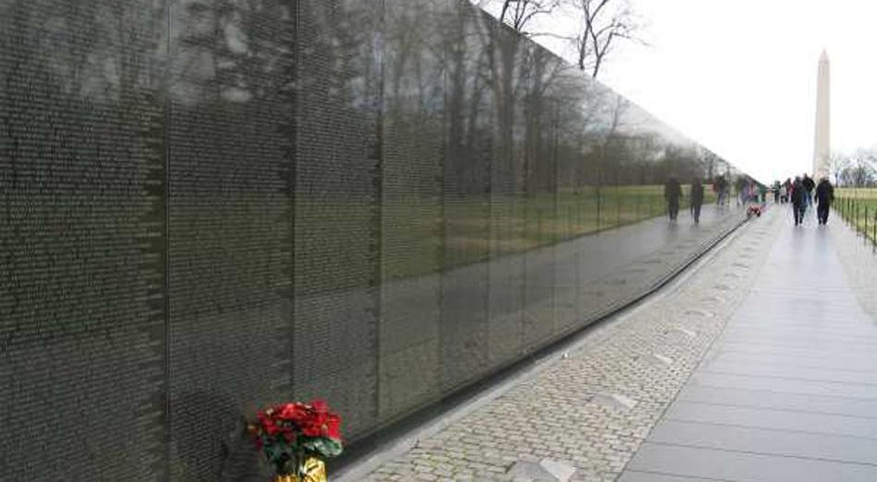
I lost more than my innocence. Mark Lott

Slide 17
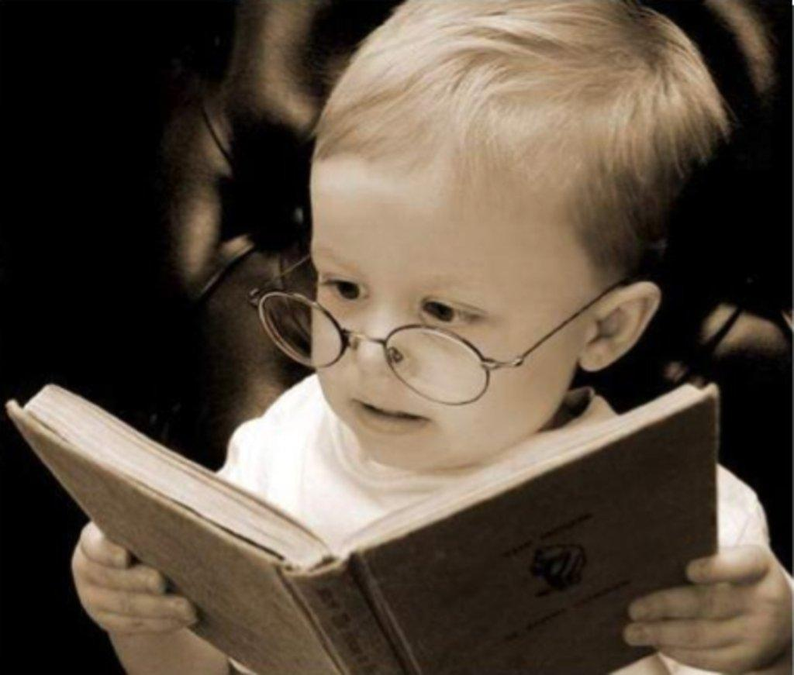
Tired of being the smart kid. Keith Jones

Slide 18

What would we do without liars? Kate Olsen

Slide 19
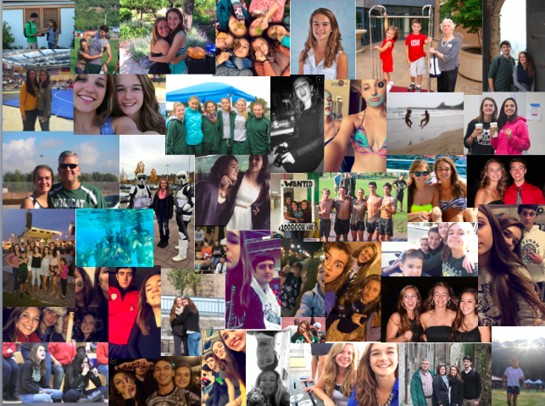

Six words will never define me.
Katye Cairns

Slide 20
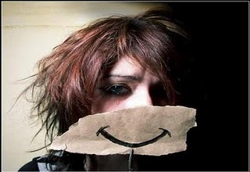
I smile to fool what’s behind. Aaliyah Woods

Slide 21
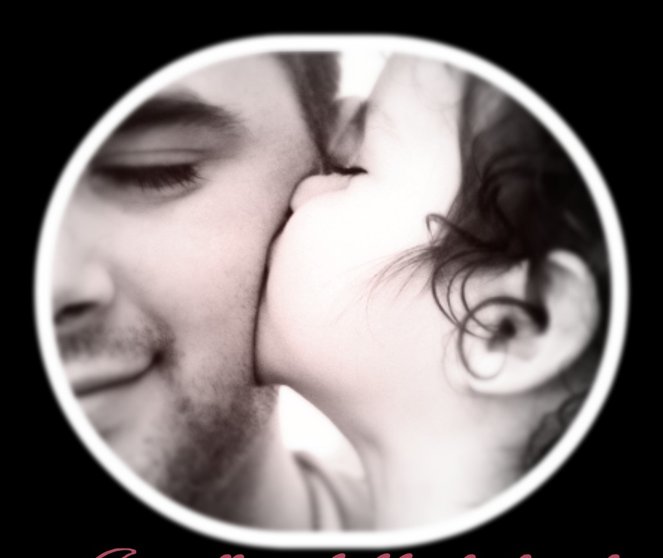
I’m still my daddy’s little girl. Rhiannon Silva

Slide 22
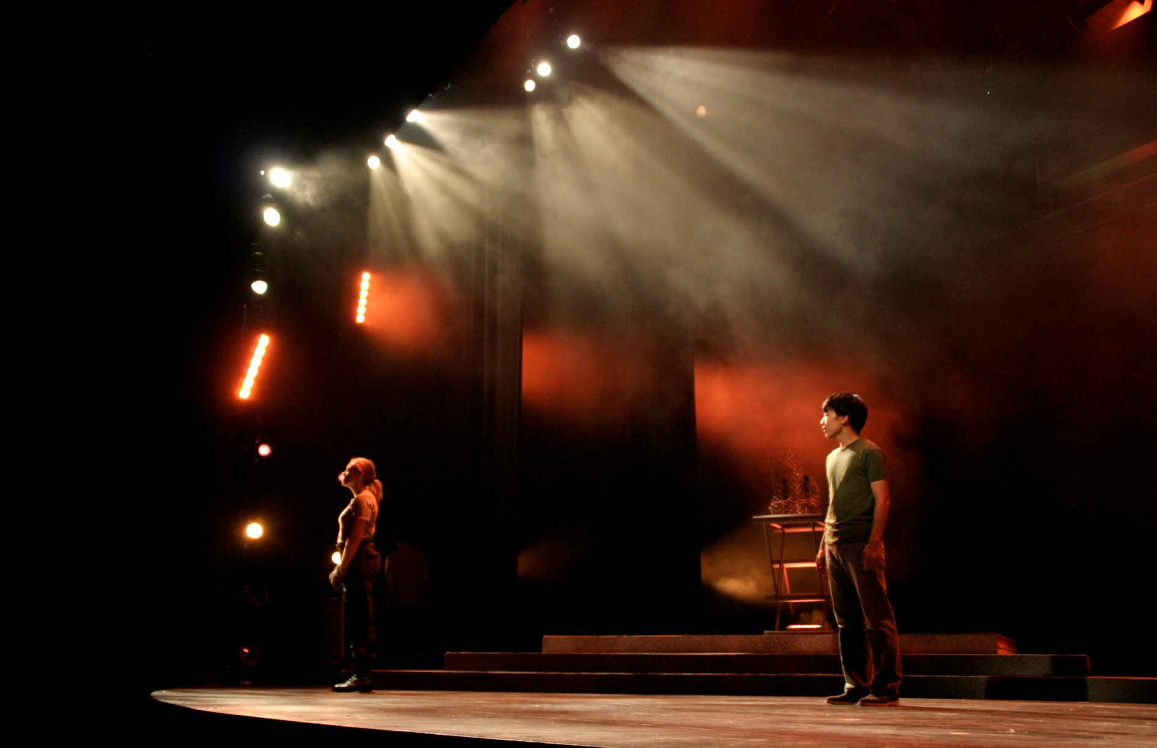
Found myself through playing other people.
Diana Carl

Slide 23

Missing = Four sisters, four time zones. Lizzy Allred

Slide 24

I love all our random conversations. Isabell Pelley

Slide 25

When you weren’t there, books were. Sean Salas

Slide 26
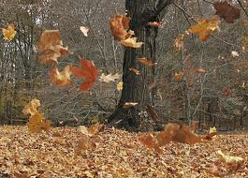
Time passed on. We grew up. Taylor Gauff

Slide 27

The Phoenix burns before its rebirth.
Carter Martin

Slide 28
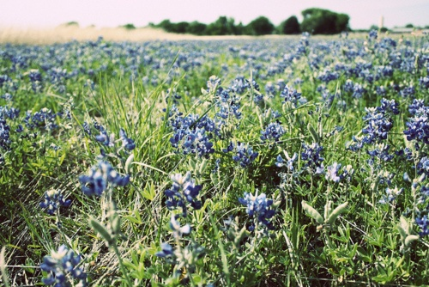
5402 miles away from my home. Megan Mullen

Slide 29
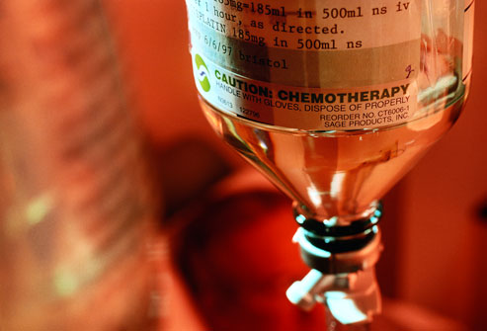
In honor of my dad, I devote the following memoir.
Drained his strength, not his will. Drayce Howard

Slide 30

No Flowers
No Funeral
No Nothing
I found my mother’s suicide note.
Anne Kitchen

Slide 31
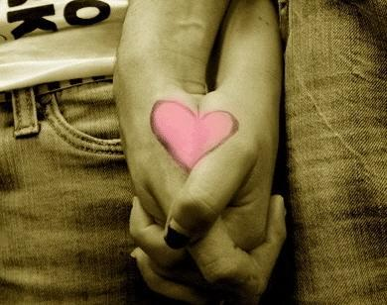
Followed the rules. Wished I didn’t. Rina Rodriguez

Slide 32
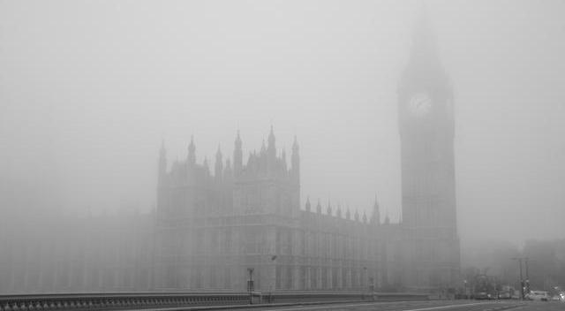
London – walked around in a fog.
Barry Sanders

Slide 33
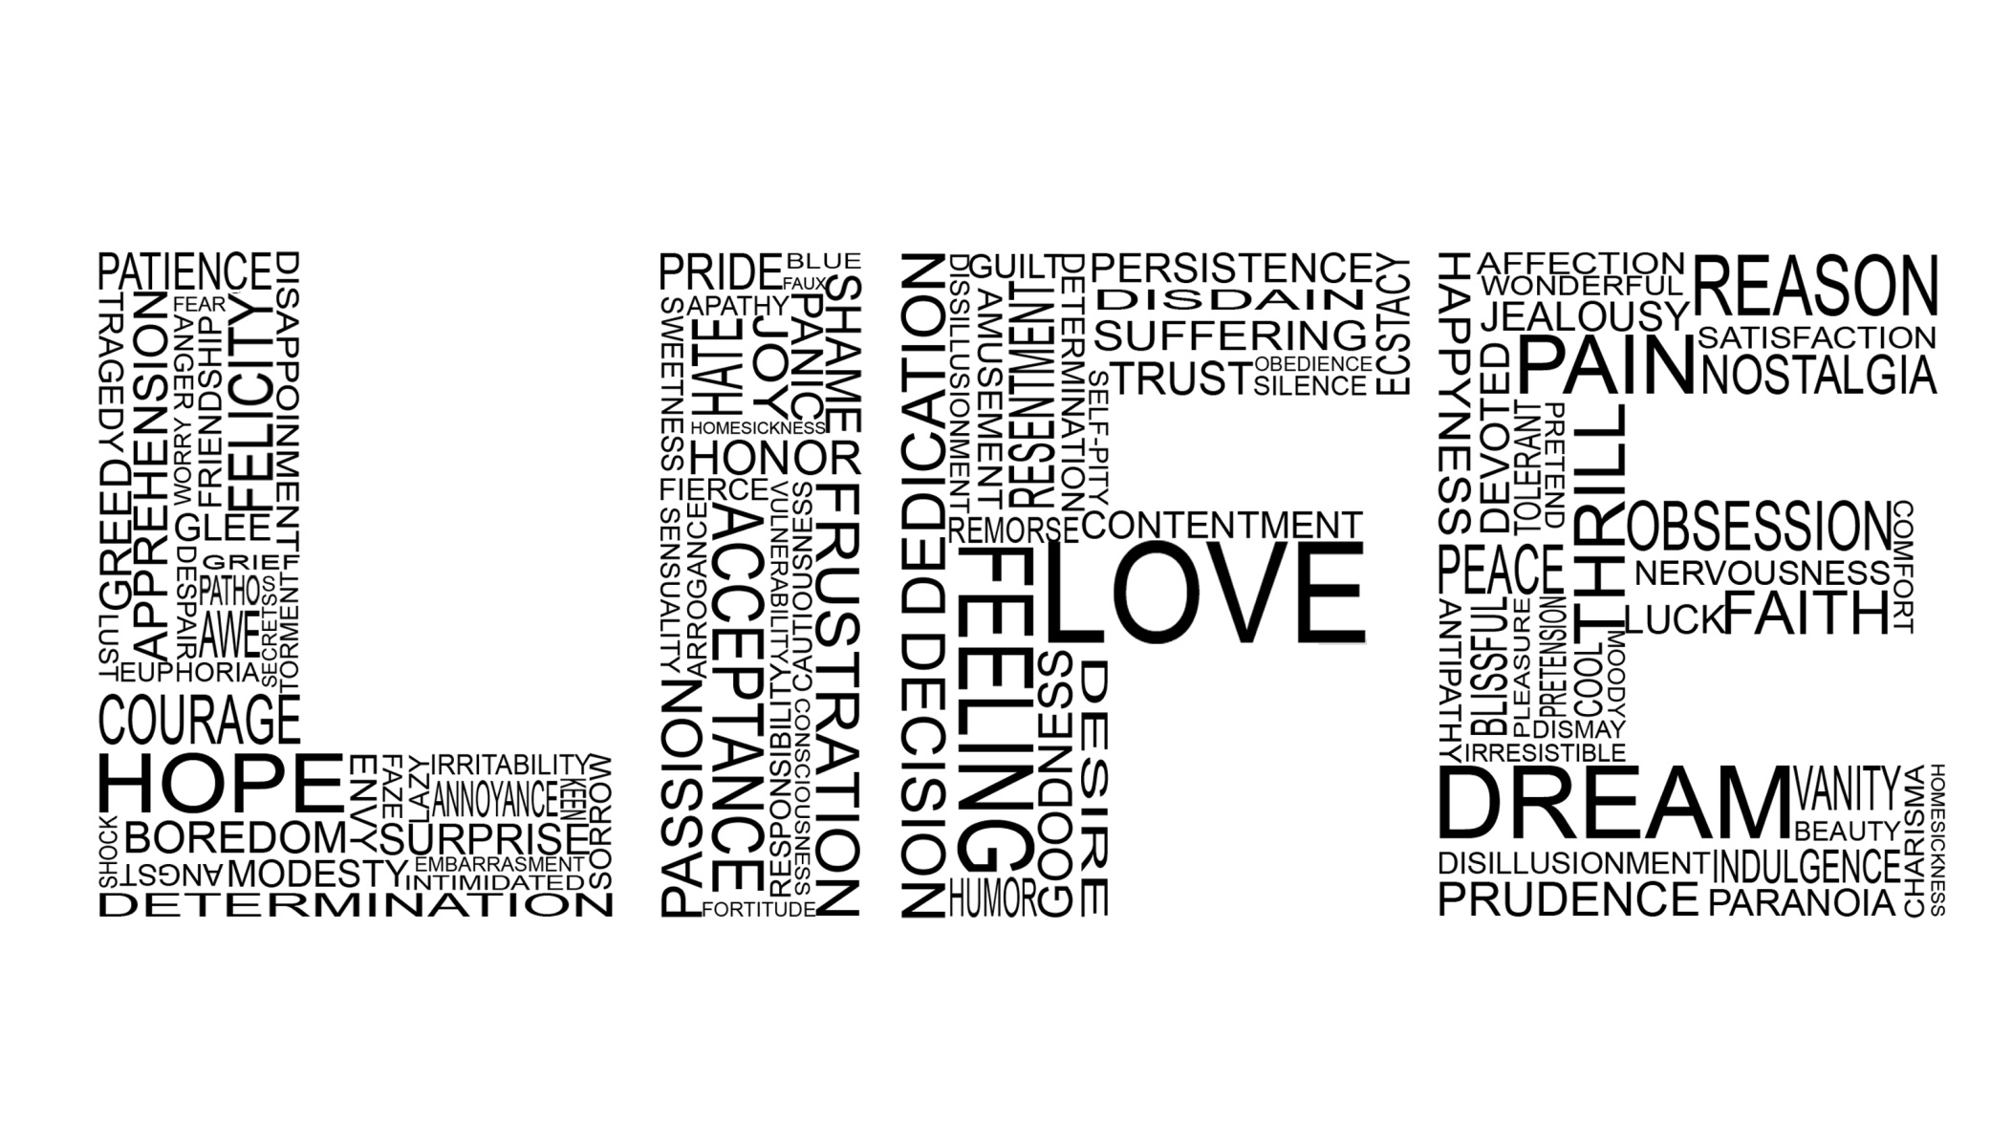
Six words don’t determine my life.
Kayli Rembert

Slide 34
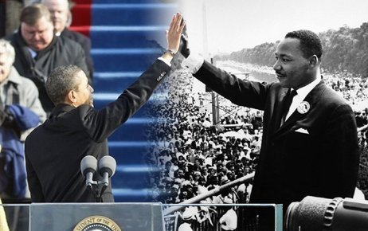
Live by your beliefs and go. Romina Fears

Slide 35
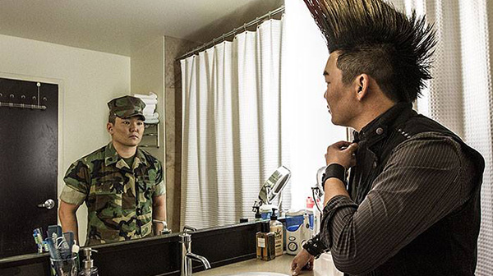
Not sure who’s in the mirror.
Seamus Wade

Slide 36
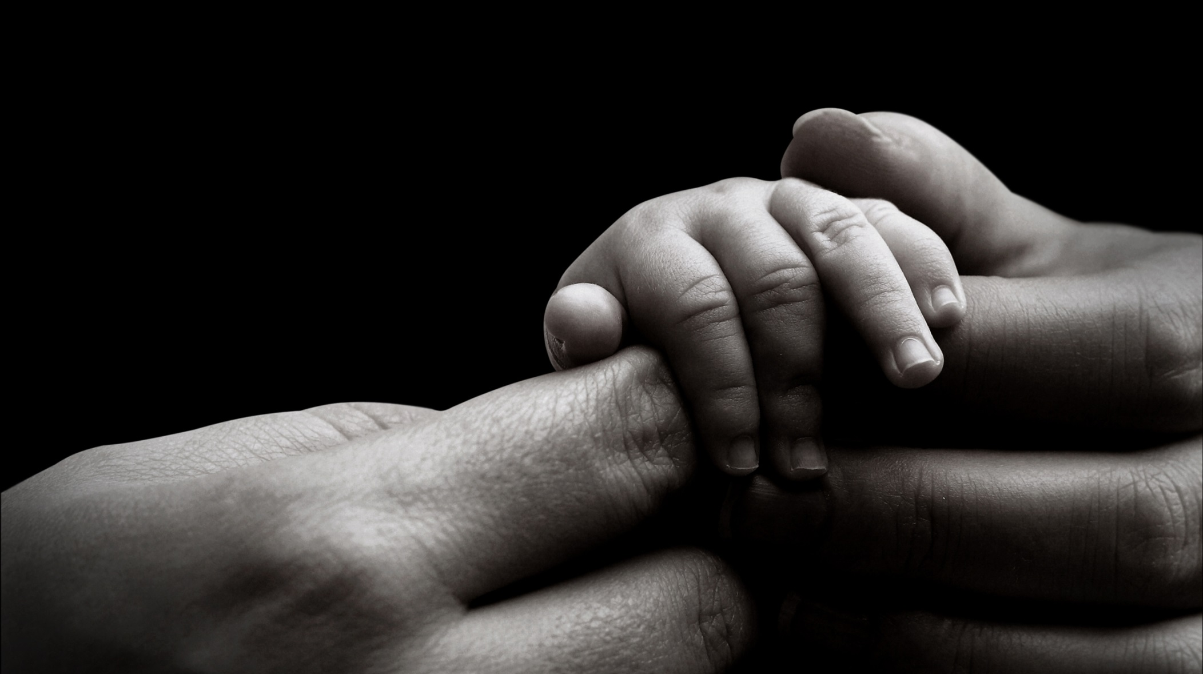
Adopted, yes. Unwanted, I think not.
Andrew Smith

Slide 37

Doneness counts, but not done yet. Sandra Effinger
Doneness counts, but not done yet.
Sandra Effinger

Slide 38
Discussion Question
How is it both possible and impossible to distill the essence of who you are into six words? Which of these authors do you think did the best job of it and why?

Slide 39
6 TIPS FOR GREAT 6-WORD MEMOIRS
by Rachel Fershleiser
Be specific.
Be honest.
Forget the thesaurus.
Use your own speaking voice.
Experiment with structure. Two three-word sentences. Three two-word sentences. One statement or six separate ones. Repetition can be powerful and punctuation is our friend.

Slide 40
6 TIPS FOR GREAT 6-WORD MEMOIRS
by Rachel Fershleiser
Stop trying so hard. Write carelessly; edit carefully. Throw a million ideas down and then decide. These aren't epic novels or Supreme Court decisions. Just start scribbling and see what catches your eye. In our experience, peoples' first instincts are usually the best.

Slide 41
Let’s get started…
On a separate piece of paper, create a list of words, phrases, sentences that describe you and your life. Use nouns, verbs, adjectives, synonyms. You will have 10 minutes to complete this. Do not stop writing until time is called. You are going for quantity, not quality. Do not worry about spelling errors, just write!
GO!

Slide 42
Your Task
Write your own Six-Word Memoir and find the perfect illustration for your words. This will be shared, so think first.
Copy a blank slide at the end of this presentation.
Use your 6 words. Do not change font type or size.
Use your illustration. You may re-size it only slightly.
Use your name.
Write a thoughtful Reflection Paragraph.

Slide 43
Reflection Paragraph:
Why did you choose this story to tell?
Why did you choose the words you did?
How do your word choices affect the meaning of your memoir?
What do you want the reader to know about you based on these six words?
What message did you want to convey?
Be specific and thoughtful in your reflection.

Slide 44
Grading Rubric
Brainstorming Freewrite is complete. And attached to memoir. (Words you liked are circled, some added, changed). | 10pts.
Includes a six-word memoir with vivid, powerful, and specific word choice. Your memoir is spelled correctly. Your name is on the front. | 25 pts.
Includes a well-chosen photograph that compliments the memoir without distracting from the text. | 25pts.
You wrote a reflection paragraph explaining your memoir. (Your paragraph has at least five sentences.) | 20pts.
Contains no errors in spelling, grammar, or punctuation. | 20 pts.
TOTAL | _______/100pts

Slide 45
Adopted, yes. Unwanted, I think not.
Andrew Smith

Slide 46
Adopted, yes. Unwanted, I think not.
Andrew Smith
Being adopted gave me a different perspective on what it means to feel at home. Biology had nothing to do with belonging or not belonging. The only black child in a family with white parents and white brothers – I belonged. Moving every two years for my dad’s Navy job – I belonged. The open love I received made me feel that I belonged – in this family, in this world, in this space. I am at home with the ones I love and who love me. We are connected, always.

Slide 47
Put your six words here, please.
First Last

Slide 48
Put your six words here, please.
First Last

